Slide 1

2018 Seminar on Predictive Modeling:
Introduction
Jeffrey Strickland, Ph.D., CMSP, ASEP
CEO Humalytica Analytics
Proprietor Simulation Educators

Slide 2

Ares I Crew Launch Vehicle – NASA Moonshots
First time:
Never before has NASA conducted a first-time successful test launch of a new manned-launch system, until Ares I. Dr. Jeffrey Strickland performed the modeling and simulation engineering for Launch Availability and Reliability.
A few weeks after Ares I launched from Cape Canaveral, President Obama canceled the manned space-flight program.

Slide 3
About Dr. Jeffrey Strickland
Ph.D. in Mathematics
M.S. in Operations Research
B.S. in Biology
A.A.S. in Allied Health – Emergency Medical Technician
Certified Modeling and Simulation Professional
Microsoft Certified Technology Specialist
Companies Owned
  Simulation Educators
  Humalytica Analytics
  Legacy Family Travel
Husband, Father, Hiker, Medic
Companies Worked For
  US Army
  NASA
  Northrop Grumman
  Clarity Solution Group
  USAA

Slide 4
Data Analytics Project
Automobile Loan Uplift Model
Automobile Insurance Uplift Model
Term Life Insurance Uplift Model
Credit Card Uplift Model
Life Event Models (Marriage, Job Change)
Engagement Models – Financial Services
Call Center – Member Service Representatives
Web Life Interest Model
Text Analytics of Credit Card Transactions
Auto Experience Model
Used and New Car Purchases
Homebuyer Model Acquisition Model
Home Experience Model
Business Process Mapping
Personna Model

Slide 5
Teaching Experience
United States Military Academy – Department of Mathematical Sciences
University of Northern Colorado – Department of Mathematics and Computer Science
University Of Alabama in Huntsville – Center for Modeling, Simulation and Analysis
Athens University – Department of Mathematics
Florida Institute of Technology – School of Advanced Graduate Studies
George Washington University – Curriculum Development
VIT University – Data Analytics in SITE

Slide 6
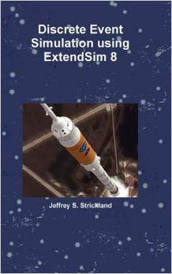

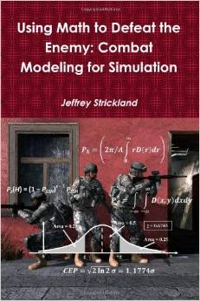


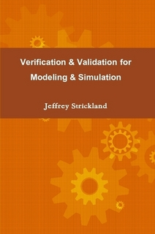
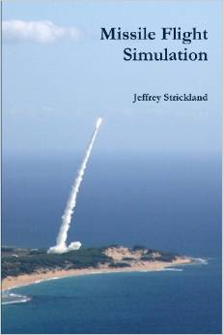
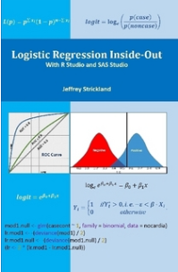
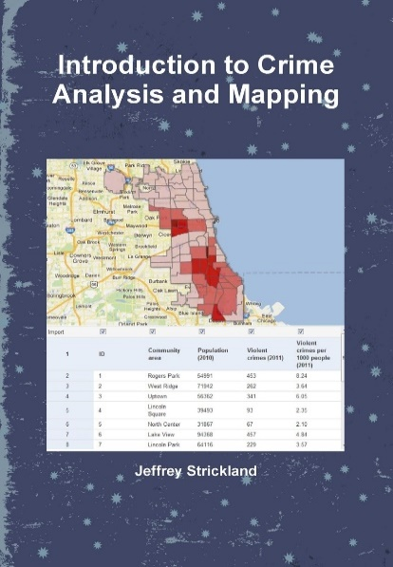

Some Books by Dr. Jeffrey Strickland

Slide 7
“Let us above all take heed that one misfortune does not befall us. Let us not become haters of logical debate as some people become haters of humankind; for no greater evil can befall men than to become haters of reason.”
—Plato

Slide 9
www.humalytica.com
http://www.amazon.com/Jeffrey-Strickland/e/B00IQ69QZK/
http://www.lulu.com/spotlight/strickland_jeffrey

